Slide 1

Course Portfolio for Fall 2024
Katherine Stanton
ITAI1378 – Computer Vision
December 11, 2024
GitHUb Repository:
https://github.com/ktgraze/Course-Portfolio-Final-ITAI1378.git

Slide 2
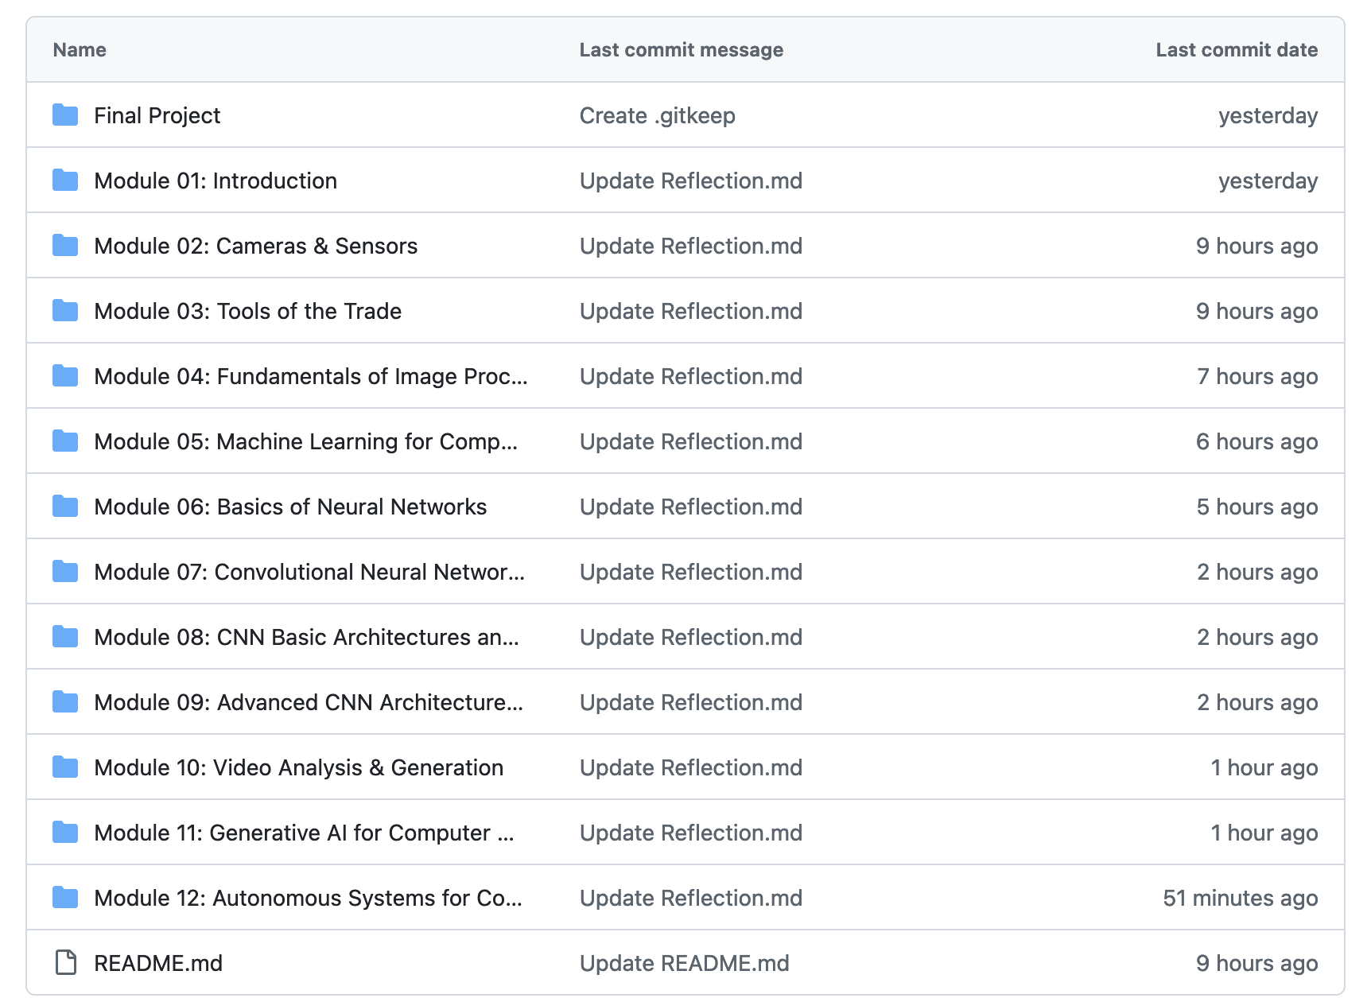
• This portfolio is intended to showcase everything I learned in this course, my individual labs, the skills I built upon, and my contributions to group projects throughout the semester. My GitHub repository is organized by module, with each of the 12 modules assigned its own folder, which contains a file each for all module group assignments, individual labs, and a reflection.
• Key modules that I feel have made a lasting impression include Module 04 – on the fundamentals of Image Processing, Module 06 - an introduction to Basic Neural Networks, and Module 07 - which covers Convolutional Neural Networks, with the accompanying group assignment that called for us to create a Manual CNN.
• This course dramatically improved my proficiency with GitHub, introduced me to new frameworks like Keras and PyTorch and libraries like TensorFlow and challenged me to train my own Computer Vision models on tasks like image classification and object detection.
Screenshot of my GitHub repository’s outer-structure. Each folder contains labeled files of assignments, labs, and reflections.

Slide 3
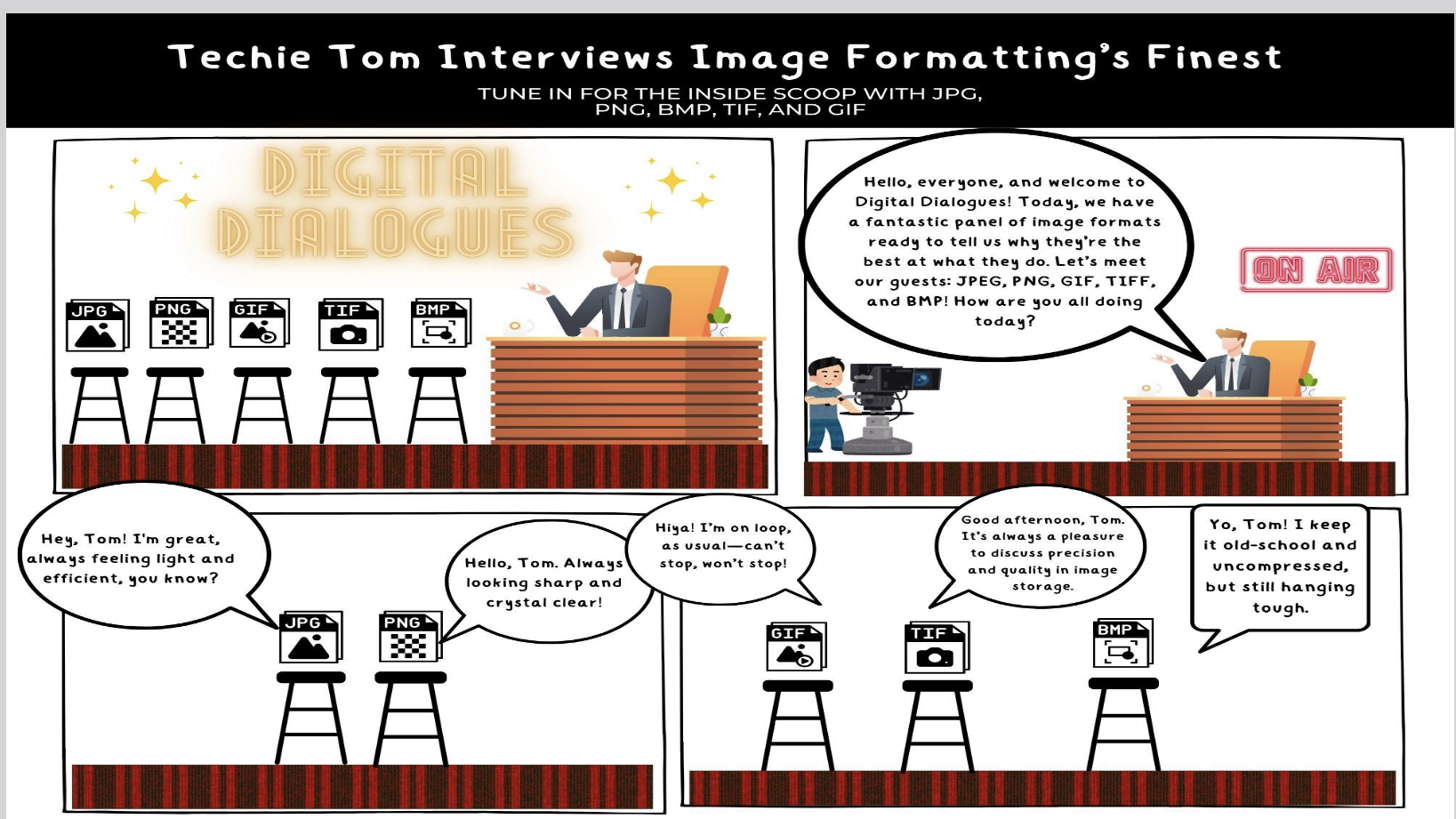
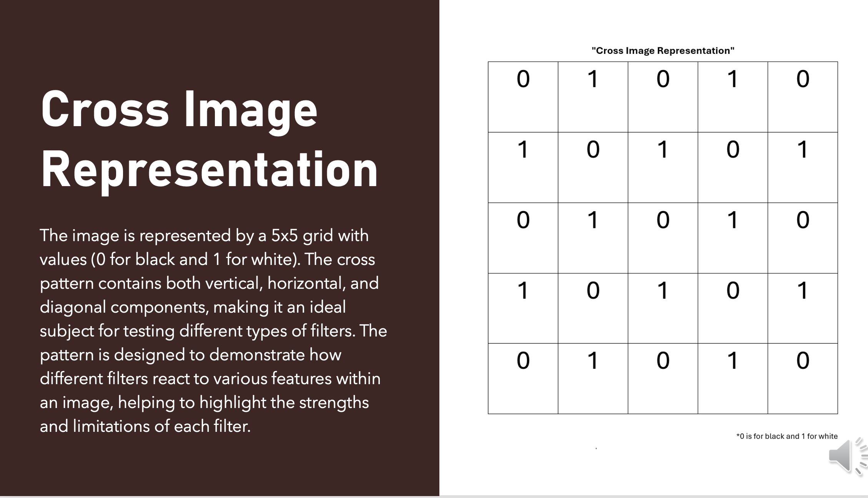
Key Highlights
Module 04 – Fundamentals of Image Processing
The group assignment for this module tasked us with creating a mock interview of image formats (JPEG, PNG, GIF, BMP, and TIFF) discussing their strengths and weaknesses.
This assignment allowed us to work collaboratively and to get creative with our interpretation of the prompt.
This exercise introduced me to working with Canva, designing comic panels, adjusting image layer depth, and most importantly the basics of image formats.
Below is the first panel of the comic.
Module 07 – Convolutional Neural Networks
This module introduced us to the basics of CNNs. For the group assignment we were tasked with making a Manual CNN by creating a simplified image made up of grids (we chose a 5x5 cross image). Each grid either had a 1 or a 0 representing the color white and black, respectively. Next, we created three “filters” that slid across the original image, replicating an actual convolution.
This assignment stands out in my learning journey as a helpful way to understand CNNs by breaking down the process to a molecular level. Replicating the convolutions ourselves and observing how each filter reacts to various features was an enjoyable way to form a greater understanding of CNNs and their importance in the world of Computer Vision.
Below is our original image before filters are applied.

Slide 4
Reflections and Resources
Throughout the course of this semester, I feel as though I have built upon my educational foundation. Beginning with the basics of Computer Vision, from the early days of its history, to current camera and sensor technology. To then going into depth on Basic Neural Networks, Convolutional Neural Networks, Image Processing, Transfer Learning, and Intelligent Agents. My understanding of this sub-field of AI has deepened dramatically.
Some challenges I faced included time management; I struggled at times to manage my workload while taking other classes. Going into this course, my experience with Python was very new, having only been introduced to it through a ML course over the Summer. Now, after completing many more labs and exploring different Jupyter Notebooks/ workshops in depth, I feel that my Python proficiency is slowly improving, a momentum I hope to keep up in the future. Finally, I ran into the problem of a lack of computational resources on occasion and this was a lesson in when to take a sample of a dataset instead of working with the entire dataset and on the limitations of Google Colab free tier vs Pro.
One source I found to be particularly invaluable in my research was Turing Post’s series of articles on the History of Computer Vision. The series is a detailed overview, and I’ve found myself referencing it far past Module 01’s History of CV assignment. The website offers much more - including guides on AI and a series on the History of LLMs.
Last, but not least, I have found OpenCV to be a very handy supplementary tool and educational resource while navigating this course. OpenCV offers free courses to the public, including “OpenCV Bootcamp” and ”TensorFlow 2.0 Bootcamp for Beginners”, which I hope to dive into over Winter break!

Slide 5
My experience with this course has been challenging but rewarding. I learned how to process images for machine learning, worked with algorithms new to me like, SSD (Single Shot Multibox Detector) and CNN models like VGG (Visual Geometry Group). My proficiency with GitHub has improved and I now feel much more confident working with repositories and collaboratively on the site.
In the future, I hope to only become more comfortable using GitHub, as the chances that my future career in tech will use it is high. I hope to continue to build on my knowledge of Python. Depending on the career path I choose, chances are high that some elements of this course will need to be recalled. For example, if I enter a ML role in the medical field, my prior work with Object Detection models like YOLO (You Only Look Once) and SSDs will certainly come in handy.
Thank you for visiting my portfolio and joining me on this recap of my learning journey!
GitHub Repository

